Slide 1
Senior Design Team 19: Steam Heat Controller
Team Members: Ben Jusufovic, Ben Cao, Curtis Mayberry, Thinh Luong
Advisors & Clients: Lee Harker, Jason Boyd

Slide 2
Overview
Project Overview (2 mins)
Project Plan (1 min)
Project Design (2 mins)
Project Implementation (4 mins)
Current Status (1 min)
Questions

Slide 3
Project Overview
Problem Background and Statement
The old section of Coover hall utilizes steam valves to heat adjacent rooms. A steam valve in one room can control the temperature of up to five rooms. This leads to temperature offset in the rooms and continuous adjustment of the valve in order to accommodate the individuals within each room.

Slide 4
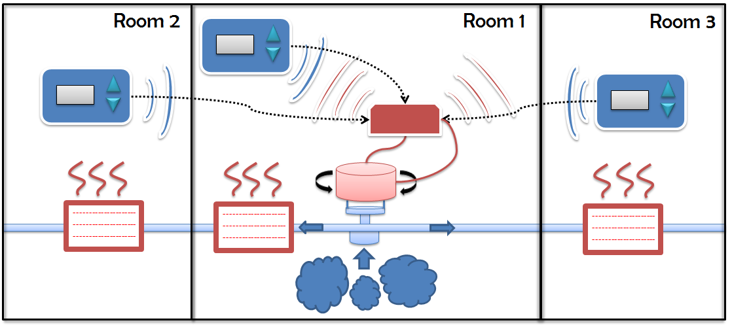
Project Overview
Requirements and Specifications
Mechanical system
Wireless interface between temperature sensor and controller
PID Temperature Controller
Network interface
Room temperature profiling
Temperature sensor located in control panel
LCD user interface
building profiling
Project budget

Slide 5
Project Plan
Component selection
Schematic and PCB Design
Routing and Components
Mechanical Interface
Web Interface
Ethernet Transceiver
Wireless Transceiver
Motor
Temperature Sensor
LCD GUI

Slide 6
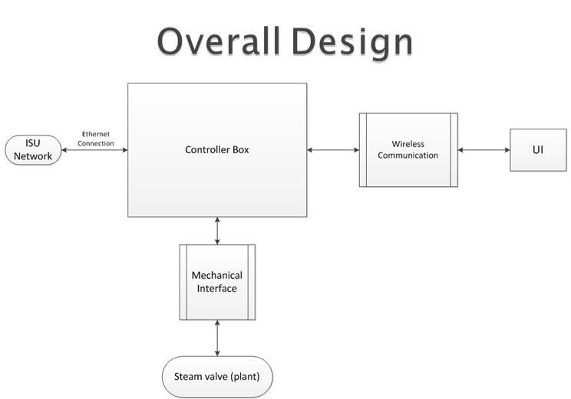
Project Design

Slide 7
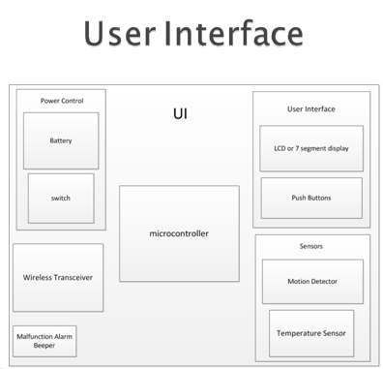
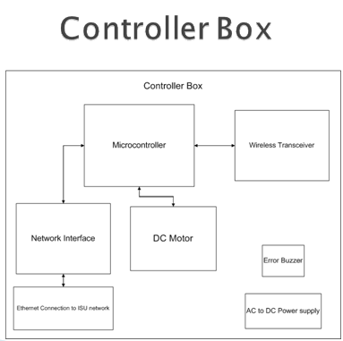
Project Design

Slide 8
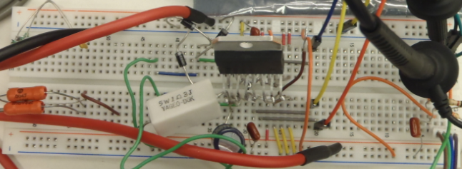
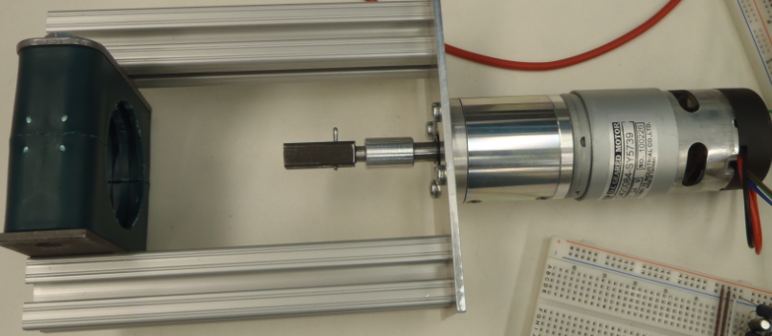
Project Implementation
Motor and Mechanical Interface

Slide 9
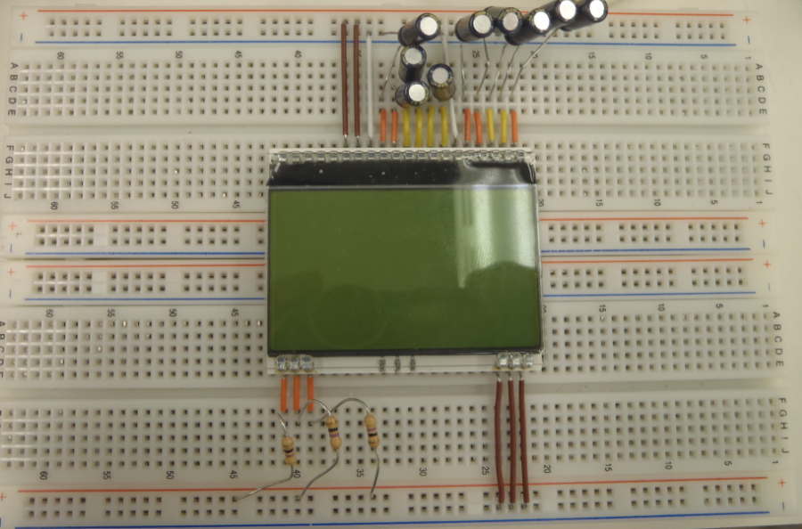
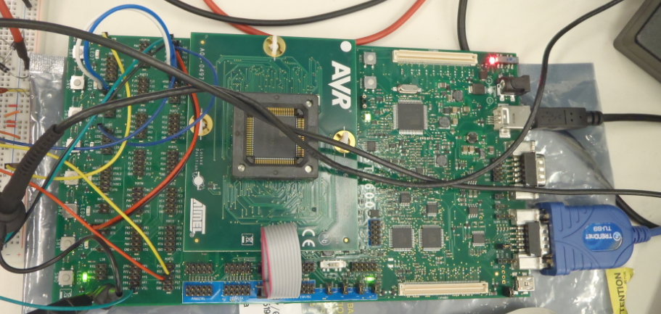
Project Implementation
LCD and AVR STK600 Development Kit

Slide 10
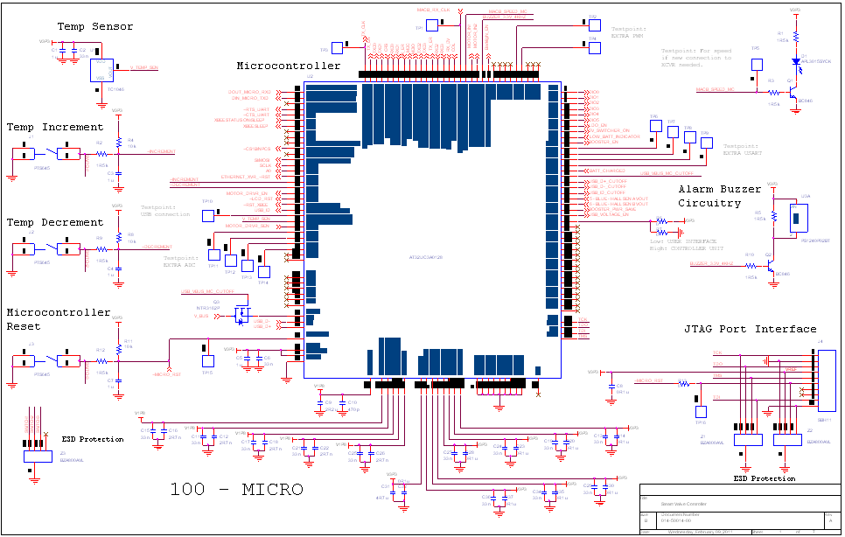
Project Implementation
Schematic and PCB Design

Slide 11
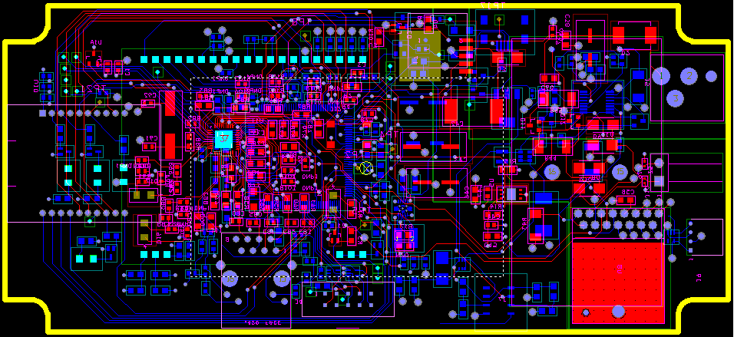
Project Implementation
Routing and Components

Slide 12
Tests
Functional
Valve calibration
Range Test
Response Test
Equalization and weighting Test
Environmental and extreme Tests
Monitored extended use testing
Software
Microcontroller
Temperature Sensor
LCD
Wireless transceiver
Networking

Slide 13
Current Status
Component selection
Schematic and PCB Design
Routing and Components
Mechanical Interface
Motor
Temperature Sensor
Web Interface
Ethernet Transceiver
Wireless Transceiver
LCD GUI
Main Programming
PID Controller Algorithm
Testing Phase

Slide 14
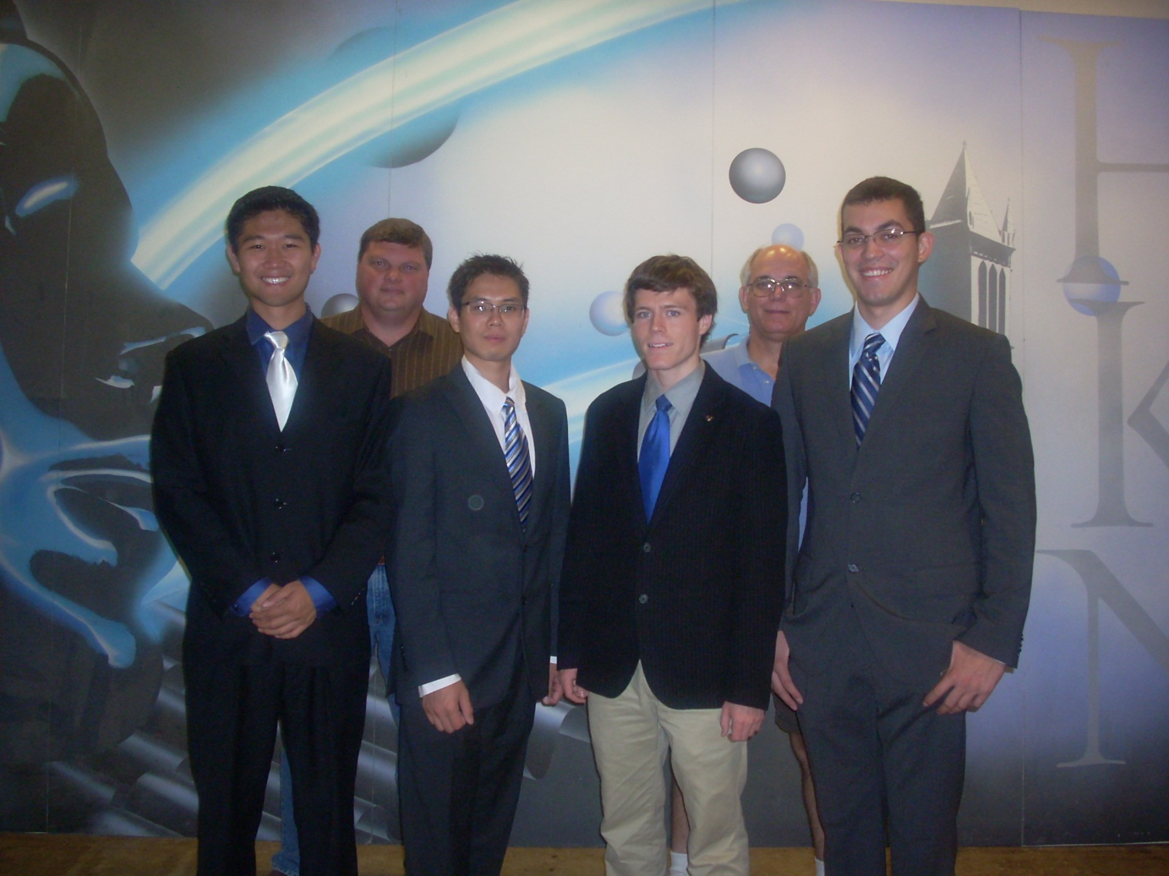
Questions?

